Slide 1

Healthcare Data Visualization platform
Shrey Jain

Slide 2

Analysing diagnostic related Groups (DRG) across USA

Slide 3
About Project
DRGs, or Diagnostic Related Groups, are an important part of healthcare analysis. Using a system called DRGs, hospital cases are categorized into groups based on the likelihood that they would use clinical resources similarly. Usually, this classification is applied in order to facilitate reimbursement.

Slide 4
Drg IN HEALthcare analysis
1.Reimbursement and Payment Systems:
Systems for healthcare reimbursement frequently employ DRGs. Hospitals are paid a certain amount for each case under a particular DRG, regardless of the true expenses that are incurred. This strategy aims to reduce healthcare expenses and increase productivity.
2.Population Health Management:
Comprehending the frequency of distinct DRGs in a community aids in the management and preparation of medical requirements. Based on the most prevalent or expensive conditions, it can direct interventions and preventive measures.
3.Research and Policy Development:
DRG data can be used by researchers and policymakers in the healthcare industry to spot patterns, create guidelines, and decide on the best ways to give care and pay for it...

Slide 5
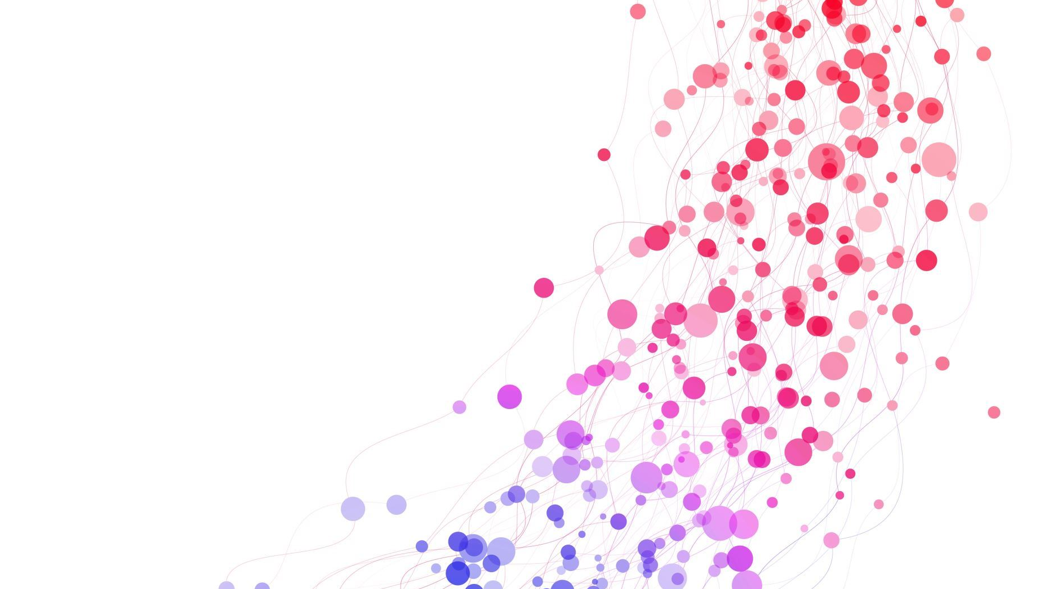
About the dataset
The attributes in the data set are:
Body System Impacted
County name DRG with Code DRG without code Hospital Address Hospital Name Hospital City Hospital State Hospital Region Hospital Zip Code ID Medical Department Responsible Year Average Covered Charges Average Medicare Payments Average Total Payments Total Discharges

Slide 6

purpose
Q1. What are the total discharges by DRG?
Q2. What are the total discharges by each Body System Impacted?
Q3. What is the average cost for a certain disease nationwide?
Q4. What are the total discharges by state hospital & time?
Q5. Which hospital have provided medical services for a particular DRG & its average total payments?
Q6. What is the average range a patient have to pay if he has a disease?

Slide 7
Demo

Slide 8
Thank You

